Slide 1
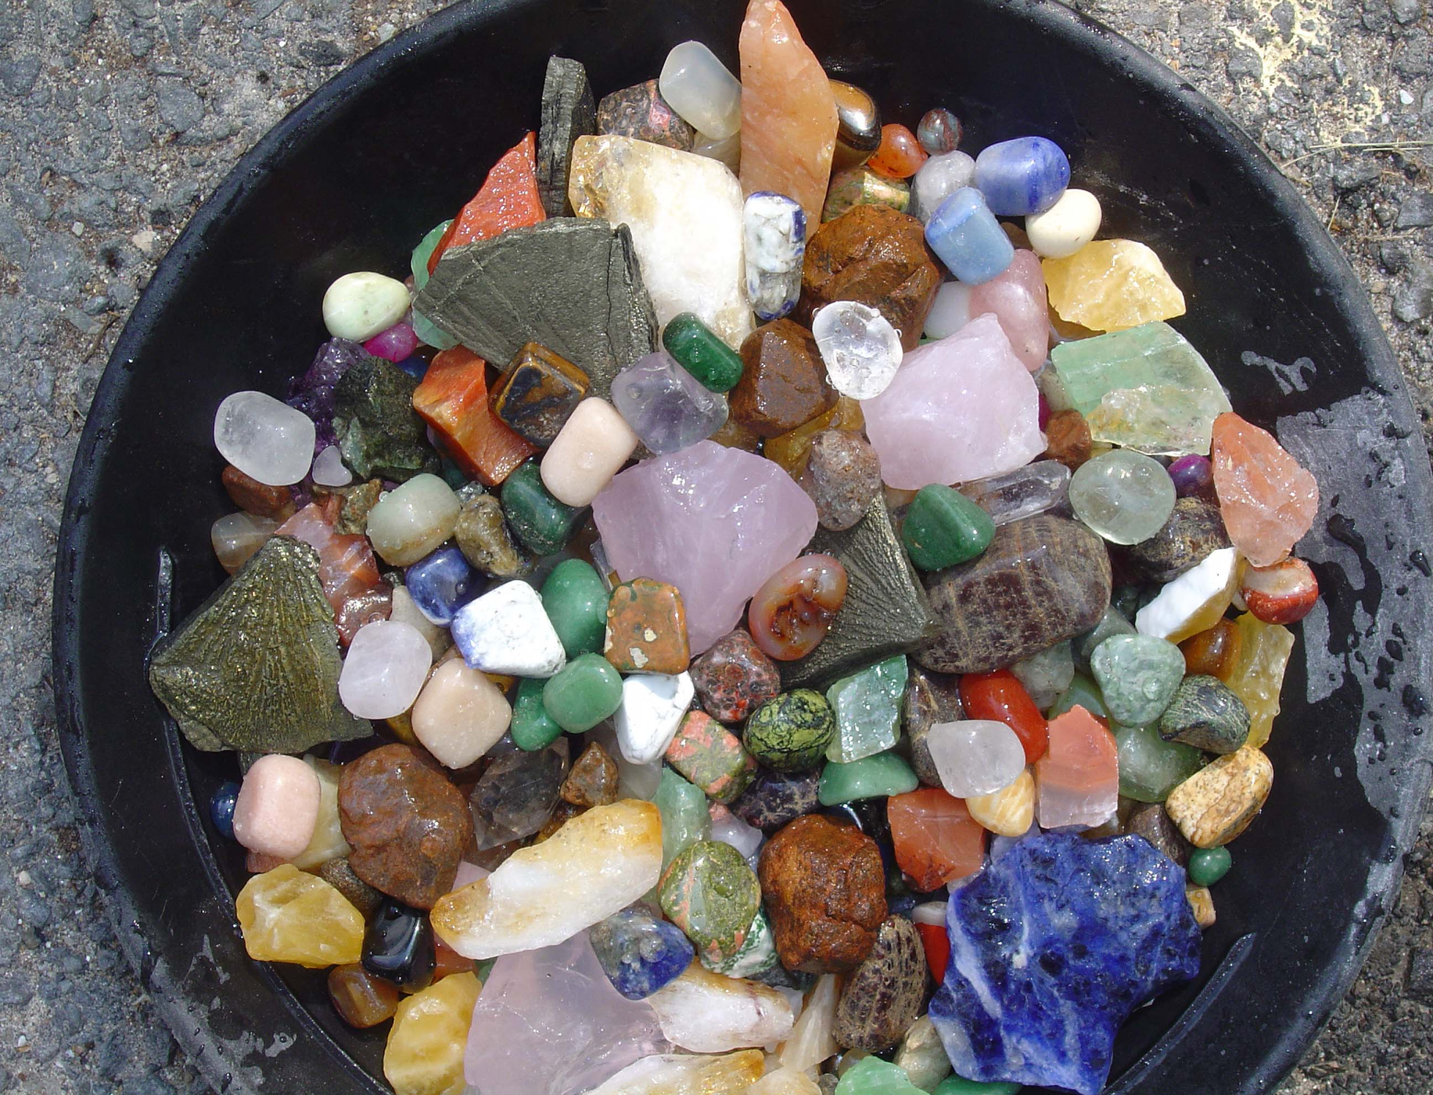
What is a mineral

Slide 2
Mineral A mineral is a naturally formed inorganic, solid with a crystalline structure. * In order to be classified as a mineral it must meet all four requirements.

Slide 3
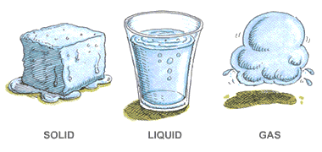
Is it a solid????
Minerals cannot be liquids or gases

Slide 4
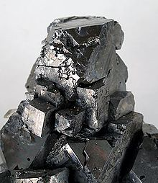
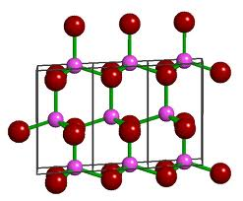
Does it have a crystalline structure?
Minerals are crystals that have repeating inner structure that is often seen in the shape of the crystal

Slide 5
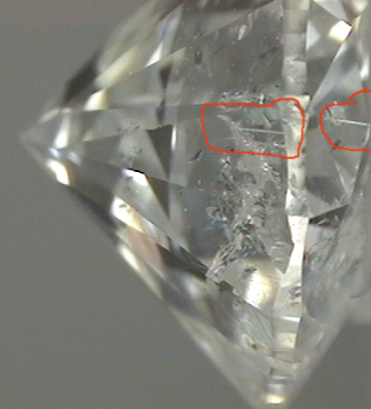
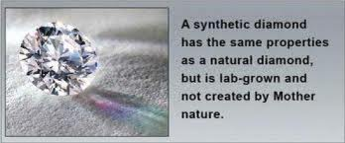
Is it formed in nature?
Materials made by people are not classified as minerals.

Slide 6
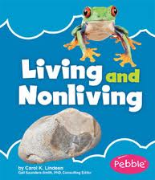
Is it nonliving material?
A mineral is inorganic, meaning it isn’t made of living things.

Slide 7
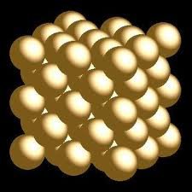
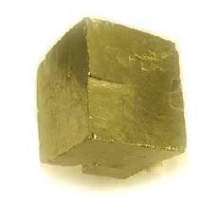
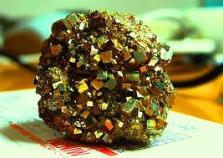
Atom – the smallest part of an element that has all the properties of that element

Slide 8
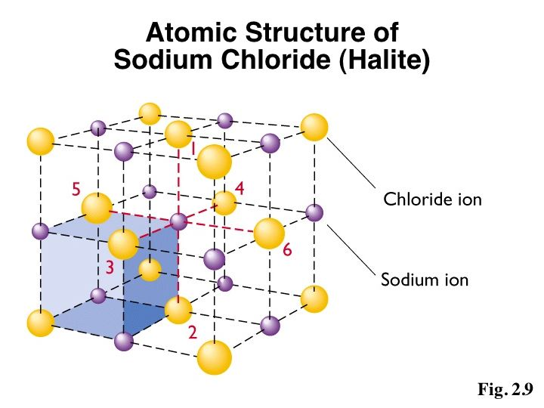
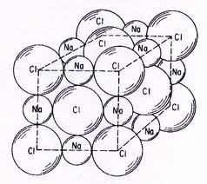
Compound – a substance made of two or more elements that have been chemically joined or bonded together.

Slide 9
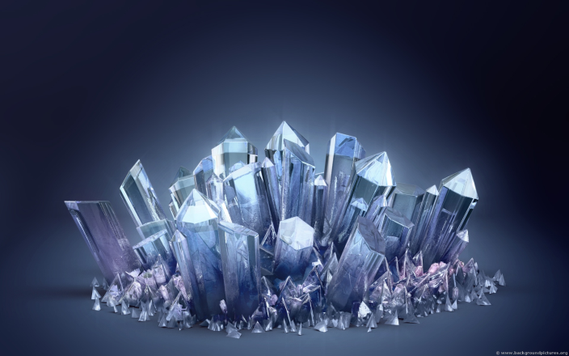
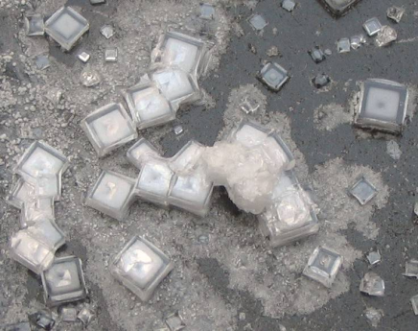
Crystals – are solid geometric forms of minerals produced by repeating patterns of atoms throughout a mineral.

Slide 10
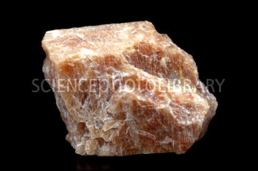
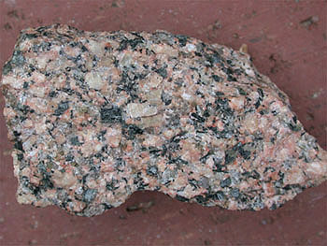
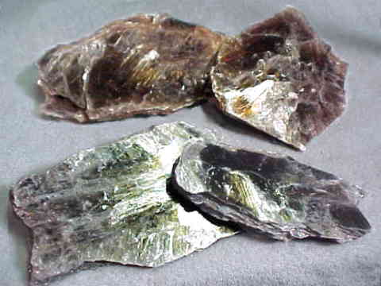
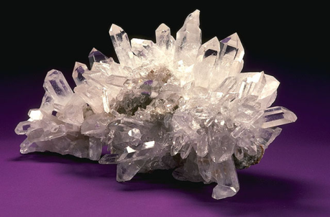
Silicate minerals
Silicate minerals – minerals that contain a combination of oxygen and silicon elements.
Silicate minerals make up 90% of the Earth’s crust. Examples of these minerals are feldspar, mica and quartz.

Slide 11
Nonsilicate Minerals in Rock
Some minerals do not contain a combination of Silicon and Oxygen, as silicate minerals do.
This group of minerals, called nonsilicates, are found in only 8% of the Earth's crust.
Nonsilicate minerals include very valuable resources to humans, such as the precious metals gold, silver, and platinum, useful metals like iron, aluminum and lead, and the precious gems diamond and ruby.

Slide 12
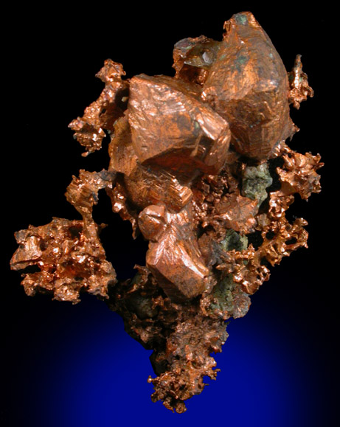
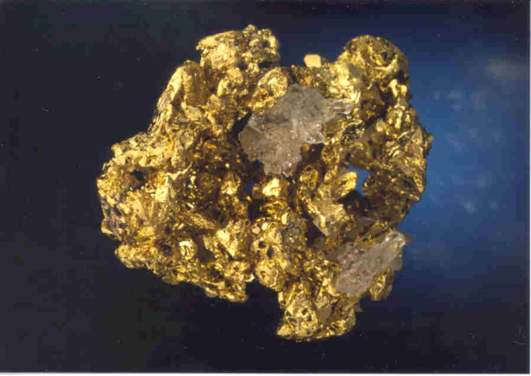
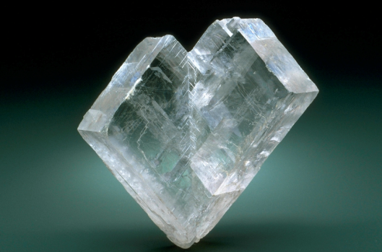
Nonsilicate minerals are separated into the following classes:
Native Elements - the native elements, such as Gold, Platinum, or Copper, are not combined with other elements. Used in jewelry, coins and electronics.
Carbonates - The carbonate elements contain a combination of Carbon and Oxygen. Some examples are calcite in limestone, or when combined with magnesium, dolomite. Used to produce cement.

Slide 13
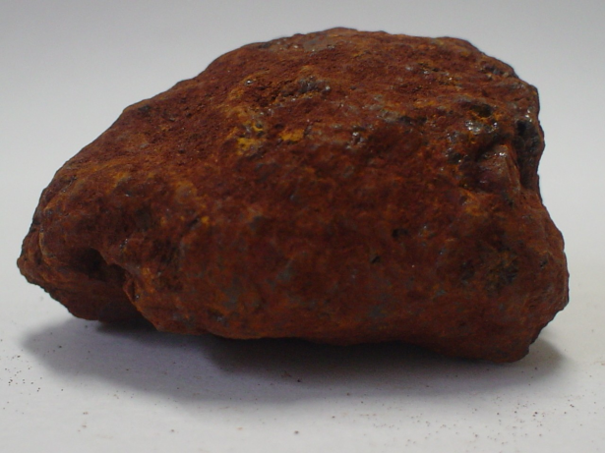
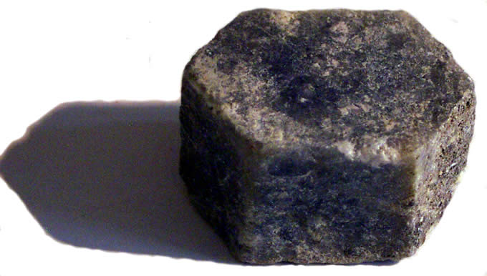
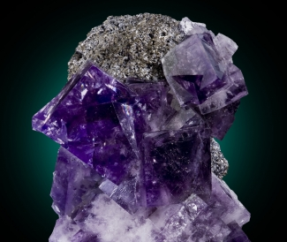
Oxides - Oxides are formed when negatively-charged Oxygen ions combine with a positive metallic ion, such as Iron. Some examples include hematite, corundum, aluminum and magnetite. Used in airplane parts and sandpaper.
•
Halides - Halides are formed when halogens such as Chlorine, Fluorine, Iodine or Bromine combine with other elements like Calcium, Sodium, or Potassium. Some examples are fluorite or chlorite. Used for chemicals and detergents.
•

Slide 14
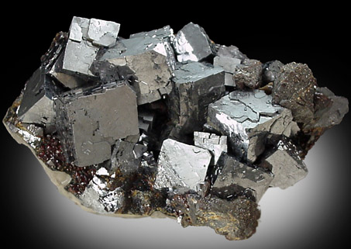
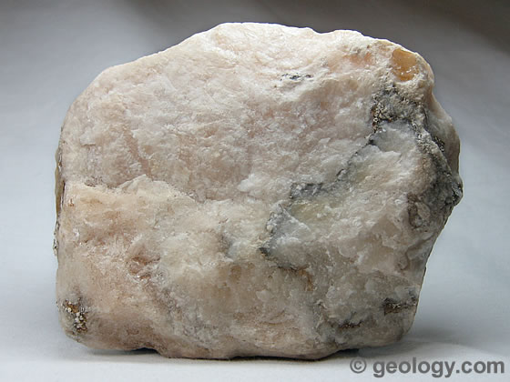
Sulfides - The sulfide elements, such as chalcocite and galena, contain Sulfur combined with one or more metallic elements. Commonly used to make batteries and electronics.
Sulfates - Sulfates are formed when a Sulfur ion sheds an electron and bonds with Oxygen, and then bonds with one or more metallic elements. An example is gypsum, used to make sheetrock and cement.

